Slide 1
What’s Assessment Data Telling You About Faculty Curriculum Assessment Skills?
Provide Faculty With Actionable Curricular Assessment Data to Engage Them in Self-Directed Learning
Bupendra Shah BSPharm, MS, PhD
Assistant Dean of Assessment and Associate Professor
Touro College of Pharmacy
Alejandra Zertuche, MBA, MS
Founder and CEO
Enflux

Slide 2
Objectives
Discuss current approaches pertaining to improving a faculty’s curricular assessment skills.
Demonstrate how Enflux dashboards can be used to engage faculty in their own self-paced, self-directed improvement of curricular assessment skills.
Discuss a framework for developing institutional capacity for facilitating curricular assessment skills improvement.

Slide 3
Faculty and Curriculum Assessment
Faculty involvement in curricular assessment (CA)
  Coordinating, teaching, and testing
  Membership in Curriculum and Assessment Committees
How do faculty develop assessment skills?
  Educational background
  Learn by doing it and reflecting
  Vicarious learning i.e. influence of others (peers, mentors, influential others; attending conferences)
  Faculty development (FDI) initiatives

Slide 4
Question 1
Which of the following approaches does your program use for FDI-CA? (Select All That Apply)
Annual FDI-CA (1-2 days)-outside expert
Annual FDI-CA (1-2 days)- inhouse expert
Year-round assessment programs
A peer-buddy/mentoring program
Visible, actionable, personalized 24x7 dashboard

Slide 5
Evolution of Faculty Development Approaches*
Age of Scholars
Age of the Developer
Age of the Network
Mid 1960s-1970
1990s
Since 2016
1950s-60s
1980s
2000s
Age of the Teacher
Age of the Learner
Age of evidence
Start of Efforts for Faculty Development on Curricular Assessment:
Seminars on Item Analysis
Workshops on Rubrics and Checklists
Effective Item Writing Skills Programs
Programs on SMART Goals/Objectives and Exam Blueprints
Programs on Active Learning Strategies
*Haras, C., Taylor, S. C., Sorcinelli, M. D., & von Hoene, L. (2017). Institutional Commitment to Teaching Excellence: Assessing the Impacts and Outcomes of Faculty Development. American Council on Education. Retrieved from https://www.acenet.edu/Documents/Institutional-Commitment-to-Teaching-Excellence.pdf

Slide 6
Question 2
Which of the following FDI-CA topics has your program used in the last 3 yrs? (Select All That Apply)
Item Analysis
Rubrics and Checklists
Question/Item Writing Skills
SMART Goals/Objectives and Exam Blueprints
Active Learning Strategies

Slide 7
Question 3
What has been the response from your faculty to these programs? Let’s be honest! (Select All That Apply)
Very helpful; learned a lot
Knew some/most of it; my approach is validated
Such a waste of my time; learned nothing new
Not for me; good for newbies
Another assessment related program :(

Slide 8
Issues with Current Approach of Faculty Development
Evidence for accountability versus for quality improvement
  Top driven versus self-driven
  Authentic versus prescriptive assessment
  Faculty performance review and importance of curricular CQI
Faculty priorities versus how faculty development programs are scheduled

Slide 9
Emerging perspectives
In what ways can FDI-CA become meaningful, flexible and provide equitable support with a diverse offering of opportunities?*
Faculty development guiding principles
  Ongoing engagement in formative, voluntary, personalized, and faculty-driven work that is meaningfully recognized by the institution
    If self-driven and recognized then will not be seen as burdensome
*Ramsay, C. & Dick, A. (2019). Pedagogical Agility in Flexible Learning Spaces: Why Faculty Development Needs to be as Adaptable as Classroom. Educause Review. https://er.educause.edu/blogs/2019/5/pedagogical-agility-in-flexible-learning-spaces

Slide 10
Emerging perspectives
Use of technology as a facilitator
  Personalized online space and network
    The opportunity to engage with their own outputs
    Make information available for learning on demand
    Provides opportunities for active and passive learning engagement
    The opportunity to engage with peers
    Potentially lead towards collaborative innovation

Slide 11

Enflux - Academic Intelligence for Student Success
Challenges
Navigating Through Uncharted Waters Without a Compass
Siloed & Suboptimal Workflows/Processes
Endless Game of Catching Up with Data Analysis
Treasure Hunt Every Time There is an Assessment or Accreditation Request
Solution
Actionable Insights
ActionPlansⓇ
Comprehensive Reports for Assessment & Accreditation
Results
Navigating Through Uncharted Waters with a GPS like Waze
Secured & Centralized Workflow Automation
Access to Dashboards with Actionable Data
Increased Team Engagement with Instant Data Gratification
Notes:
How many of you feel like you are driving without Waze and don’t know that the road is closed
https://profitsword.com/blogs/navigating-through-uncharted-waters-with-data-as-your-compass/
If you don’t have time keep up, you definitely don’t have time to catch up. Instead, let go and start fresh.
distributing data at speed, scale and efficiently

Slide 12
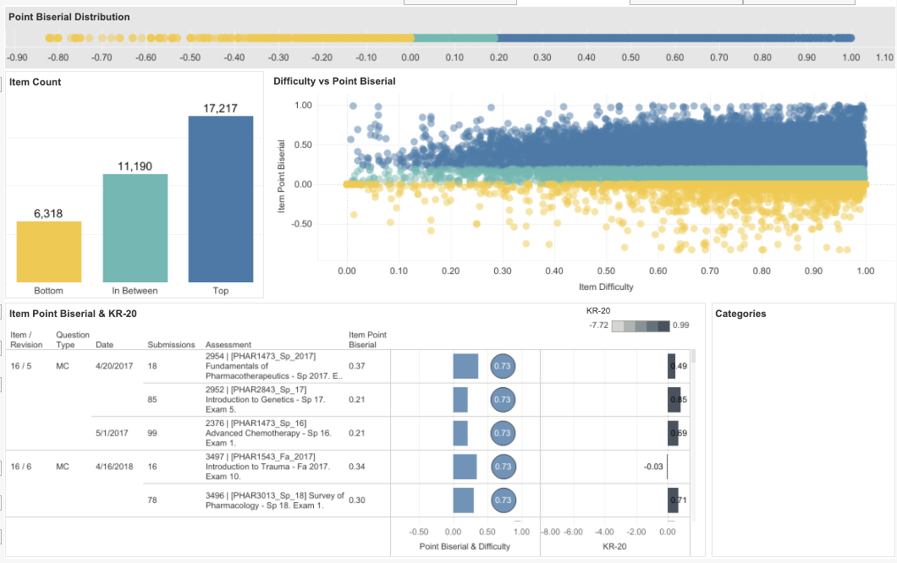
Assessment Effectiveness Dashboard
Challenges
Data: Multiple Comprehensive Assessments of a Large Group of Students
Siloed Data in Spreadsheets - Hard to Consume and Derive Actions
Periodic Assessment - At the End of Semester - Too Late to Intervene
Solution
Results
Frees Time to Focus on What Really Matters — Ensuring Student
Access to Dashboards with Relevant Information - Quickly See What Works and What Needs Improvement
Continuous Assessment - Timely Corrective Actions or Interventions
Notes:
How many of you feel like you are driving without Waze and don’t know that the road is closed
https://profitsword.com/blogs/navigating-through-uncharted-waters-with-data-as-your-compass/
If you don’t have time keep up, you definitely don’t have time to catch up. Instead, let go and start fresh.
distributing data at speed, scale and efficiently

Slide 13
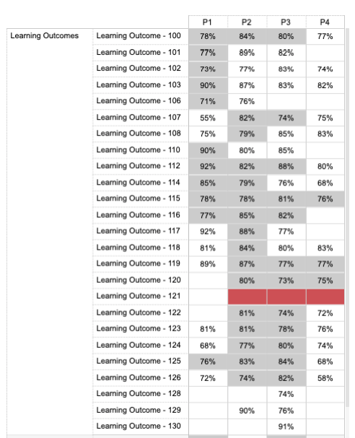
Curriculum Effectiveness Dashboard
Challenges
Are We Teaching What We’re Supposed To?
Siloed Data: Curriculum Map in a Static Spreadsheet with Assessment Data in Disparate Systems
Collaboration & Consistency - Are We Preparing Students to What’s Next?
Periodic Assessment - At the End of the Academic Year
Solution
Results
Integration of Curriculum Map and Assessment Data - Quickly See What Works and What Needs Improvement
Real-Time Communication and Tracking of Changes - Identify Repetition vs. Redundancy
Streamlined Communication and Transparency
Continuously Evaluate and Modify Curriculum Outcomes
Notes:
to prepare our students for what’s next
COLLABORATION AND CONSISTENCY
The reality is mapping never ends for school-districts that intentionally align learning standards with collaborative teaching/learning strategies to reinforce vertical, horizontal and multidisciplinary coherence. Educators must continually evaluate and modify teaching methods and lesson plans, based on what's working and what's not. The challenge is finding real-time communication and data-tracking tools to keep teachers across all grade levels and campuses informed and on the same page.

Slide 14
A Framework for Developing CA Institutional Capacity
Role of the program in preparing faculty for curricular assessment
  Determine and provide the human, technical and financial resources
  Identify the relevant leadership
  Set process and benchmarks
Curricular and Assessment Committee Leaders and Members

Slide 15
A Framework for Developing Institutional Capacity
Role of Curriculum and Assessment Committee Leaders-Members
  Change/Quality improvement agents
  Develop expertise in curricular assessment
    Targeted faculty development
  Peer outreach
    Collaborative learning of strategies for improvement
Role of Faculty
  Engaged learners and collaborators

Slide 16
Using the Assessment Effectiveness Dashboard

Slide 17
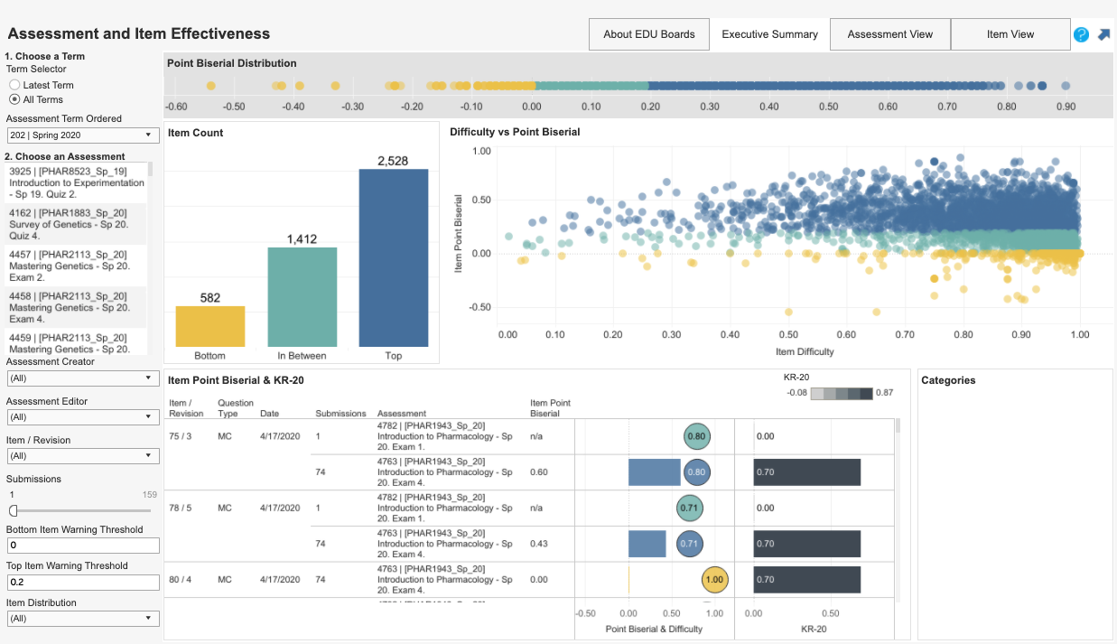

Slide 18
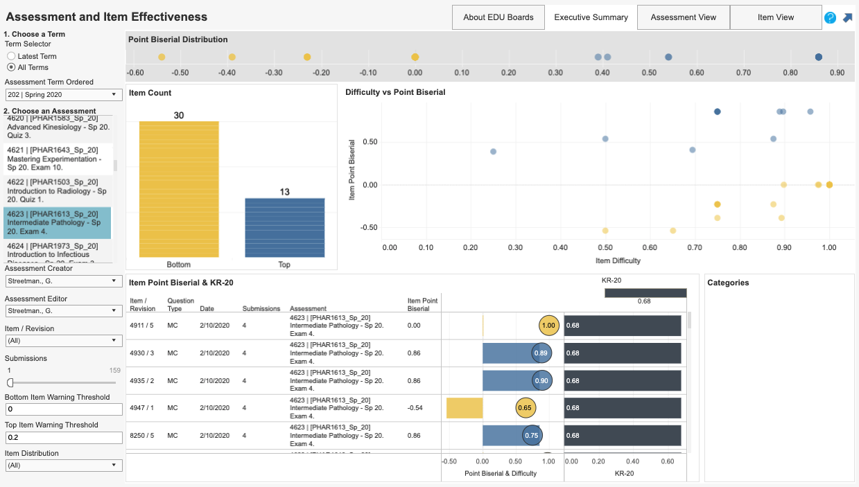

Slide 19
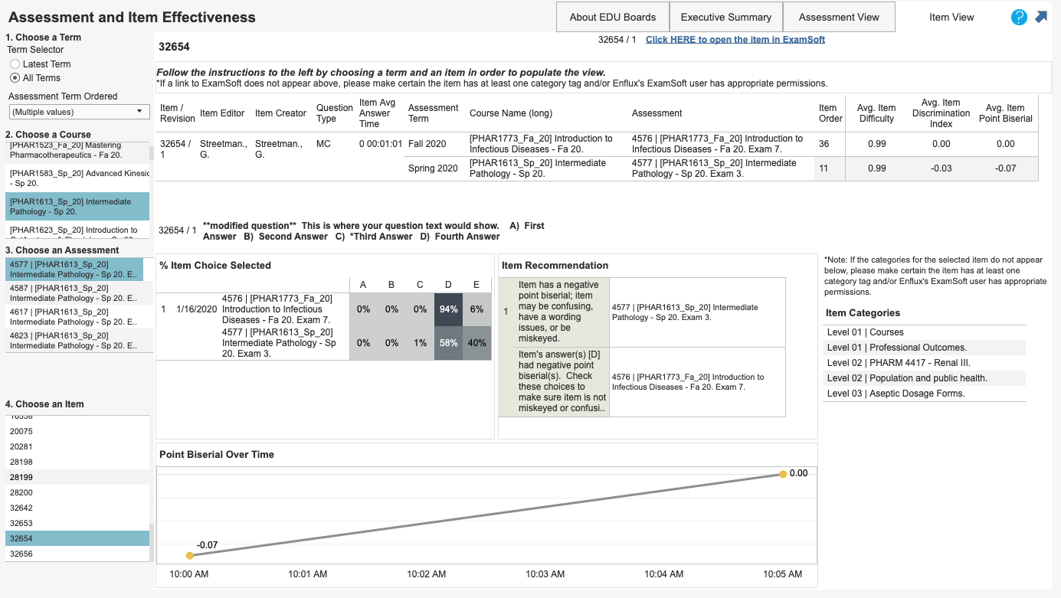

Slide 20
Summary
Colleges and academic leaders need to reexamine how they are conducting FDI-CA
  Does their effort utilize meaningful FDI principles for the contemporary faculty?
  Are they using appropriate technology as a facilitator?

Slide 21
Questions?

Slide 22
Thank you!
Bupendra Shah BSPharm, MS, PhD
Assistant Dean of Assessment and Associate Professor
Touro College of Pharmacy
bupendra.shah4@touro.edu
Alejandra Zertuche, MBA, MS
Founder and CEO
Enflux
alejandra@enflux.com

