Slide 1
Pharmacist Documentation 101
PHPR 7102 US Health Care Systems for Pharmacists
Presented by Megan Smith, PharmD, BCACP

Slide 2
Presentation Objectives
Technology
Software Solutions
Workflow
Describe advances in health information technology to support clinical documentation
Identify commonly used electronic health record platforms and describe Pharmacist eCare Plan
Tips for your community IPPE rotation
1
2
3
Notes:
Describe advances in health information technology to support clinical documentation
Describe the purpose of e-care plans and how they are used in practice
List the components of a e‐care plan and identify appropriate information to include in each section
Discuss ways of adapting dispensing workflow to support enhanced community services

Slide 3
Purpose of Documentation
Record of what has been done to achieve desired patient outcomes
Evaluates patient progress
Billing purposes
Legal requirement
Care coordination
Justify the value of our services
Notes:
Documentation in a universal format allows for communication among health care practitioners. Written documentation is one key to a successful, open-communication partnership among providers. In addition, accurate, appropriate, and concise documentation is an essential component of ensuring that the patient care provided is evident, not only for patient safety and continuity but also for cases where reimbursement and quality of care are being challenged contractually or legally.

Slide 4
Health Information Technology
Allows health care professionals and patients access and securely share medical information electronically. The goals are to
  Enhance care coordination
  Improve access to appropriate information
  Improve efficiency and reliability
  Improve quality and safety
US President Bush pushes for EHR for everyone by 2014
2004
  Health Information Technology for Economic and Clinical Health (HITECH) Act
2009
EHR
CPOE
E-prescribing
Meaningful Use
Health Information Exchange
  Patient Protection and Affordable Care Act
2010
www.healthit.gov. Accessed 6/2/19.
Notes:
References:
https://www.healthit.gov/topic/health-it-and-health-information-exchange-basics/what-hie
https://www.healthit.gov/topic/health-it-resources/health-it-curriculum-resources-educators

Slide 5
National Health Information Infrastructure
Health care data standards and technical infrastructure
Standard formats for electronically encoding data elements
Core clinical applications
EHRs, CPOE systems, digital sources of medical knowledge, and decision-support tools
Information communications systems
Development of techniques and concepts that facilitate interactions between people and computers
Notes:
National Academy of Engineering (US) and Institute of Medicine (US) Committee on Engineering and the Health Care System; Reid PP, Compton WD, Grossman JH, et al., editors. Building a Better Delivery System: A New Engineering/Health Care Partnership. Washington (DC): National Academies Press (US); 2005. 4, Information and Communications Systems: The Backbone of the Health Care Delivery System. Available from: https://www.ncbi.nlm.nih.gov/books/NBK22862/

Slide 6
Types of Medical Codes
ICD (International Classification of Diseases) | Contains codes for diseases, signs and symptoms, abnormal findings, complaints, social circumstances, and external causes of injury or diseases.
CPT (Current Procedural Terminology) | Code set, maintained by the American Medical Association (AMA) used to bill outpatient and office procedures.
HCPCS (Healthcare Common Procedure Coding System) | Healthcare procedure codes based on CPT that is leveraged for Medicare reimbursement.
Systematized Nomenclature of Medicine--Clinical Terms (SNOMED CT) | Enables the consistent, processable representation of clinical content in electronic health records.
https://www.himss.org/library/interoperability-standards/terminology-standards. Accessed 6.2.2019
Notes:
https://www.himss.org/library/interoperability-standards/terminology-standards

Slide 7
SNOMED CT
A standardized, multilingual vocabulary of terminology
Used by healthcare professionals for the electronic exchange of clinical health information
Can be mapped to other coding systems, such as ICD‐10, which helps to facilitate semantic interoperability
Codes are searchable and available for free from the National Library of Medicine (NLM)
Notes:
https://www.snomed.org/snomed-ct/five-step-briefing

Slide 8
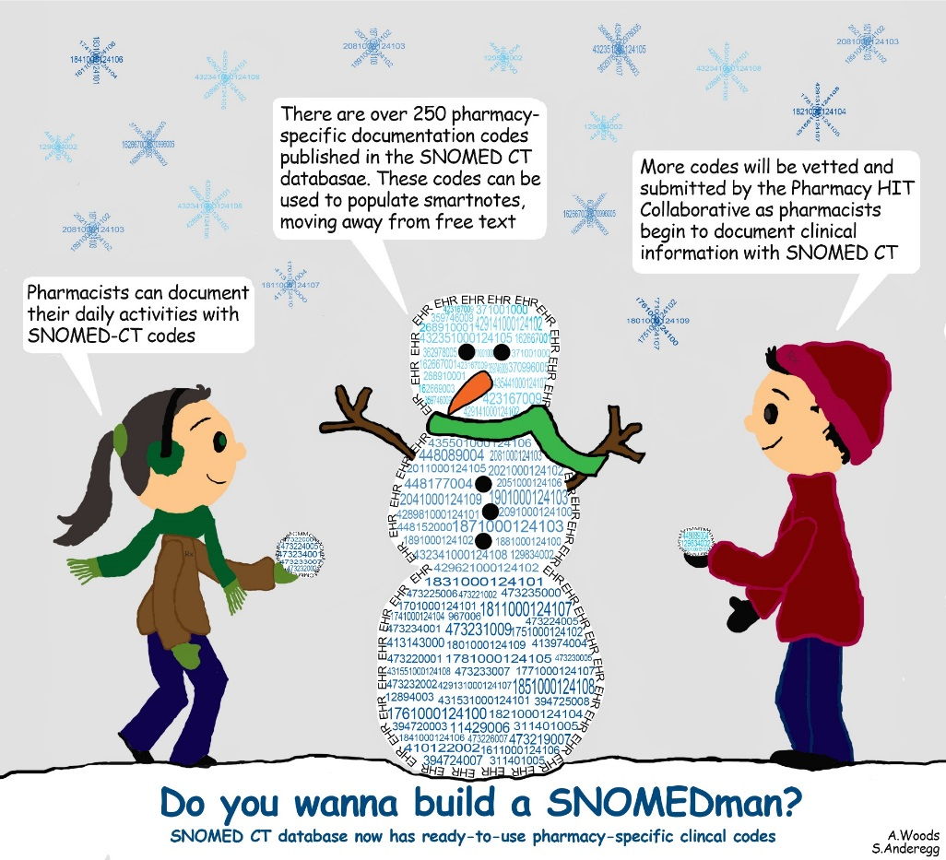
SNOMED CT in Pharmacy (**THIS IS NEW**)
SNOMED CT codes allow documentation to become more standardized
1
Efficient and precise billing for services
2
Effective communication of medication‐related problems, medication history, and associated service activities with other care team members
3
https://www.ashpintersections.org/2015/02/snomed-ct-codes-making-the-case-for-pharmacy-services-with-hard-data/

Slide 9
Select SNOMED Examples for Pharmacy
Encounter Reason | SNOMED CT code
Transition of care (finding) | 1861000124105
Transition from acute care to self-care (finding) | 448511000124101
Pharmacogenetic consultation (procedure) | 428931000124102
Medication Reconciliation (procedure) | 430193006
Comprehensive medication therapy review (procedure) | 428911000124108
Risk evaluation and mitigation strategy consultation (procedure) | 6061000124109
Medication education (procedure) | 967006
Medical equipment or device education (procedure) | 362978005
Notes:
https://www.ecareplaninitiative.com/technical-specifications

Slide 10
Select SNOMED Examples for Pharmacy
Closest Descriptor Match (Adherence) | Snomed CT code
Noncompliance with medication regimen (finding) | 129834002
Patient on numerous drugs (finding) | 182848008
Patient misunderstood treatment instructions (finding) | 182891003
Unable to self-administer medication (finding) | 2101000124106
Improper medication administration technique (finding) | 2111000124109
Unable to swallow (finding) | 249486008
Patient forgets to take medication (finding) | 408367005
Takes medication less frequently than recommended (finding) | 428951000124109
Patient unable to obtain medication (finding) | 429611000124105
Notes:
https://www.ecareplaninitiative.com/technical-specifications

Slide 11




Common EHR Systems
Health Systems and Clinics
Community Pharmacies
Notes:
A digital health care infrastructure provides many benefits over paper systems. But just like paper charts, electronic health records are stored within a clinic or hospital system and are rarely shared with your other providers. As a result, your doctors seldom have access to all your health information, which they need to give you the best care possible.
The Arkansas State Health Alliance for Records Exchange (SHARE) is a state-wide health information exchange (HIE) that solves this problem. SHARE allows participating doctors, nurses, specialists, health services professionals and public health authorities to access and securely exchange with each other real-time, electronic patient information that is protected by federal and state privacy and security laws.

Slide 12
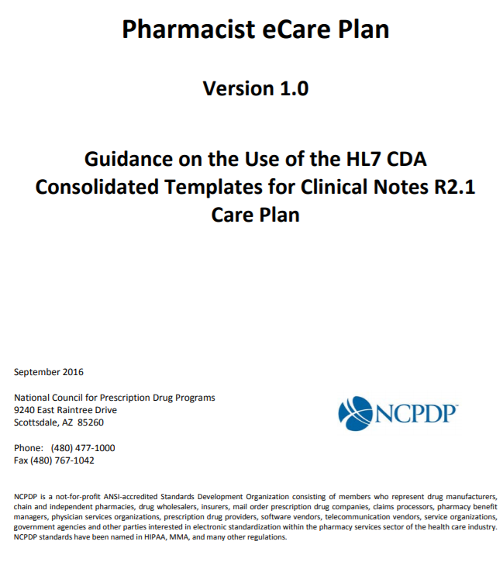
Pharmacist eCare Plan (**THIS IS NEW**)
The What
Data repository and transmission standard
  Impartial to vendor
  Open standard
Clinical data for a given patient
Not a platform
Not a clinical documentation system
www.ecareplaninitiative.com. Accessed 5.20.2019
Notes:
It is a standard that is owned and maintained by NCPDP and HL7. It is an open standard
that any technology provider can adopt. The specifications are published. Any vendor that you
work with that wants to add eCare Plan capability to their system can do so.

Slide 13
Advantages of Pharmacist eCare Plan
Designed for data exchange
Captures pharmacist’s interventions
Uses national standard for data exchange (SNOMED CT)
Capturing clinical data needed for
Value-based payment models
Payer reimbursement

Slide 14
Components of Pharmacist eCare Plan
Patient Demographic
Encounter Reasons & Type
Payer Information
Allergies
Medications (fill history and/or active medications)
Medication Therapy Problems (MTP)
Interventions and Education
Referrals
Care Coordination
Patient Goals
Outcomes
https://www.ncpdp.org/NCPDP/media/pdf/Pharmacist-eCare-Plan.pdf

Slide 15

















Software Solutions
Successfully tested and released care planning utilities that meet the standard
Pharmacy Management Embedded
Clinical Documentation Systems
Care Management System
Notes:
https://www.ecareplaninitiative.com/software-solutions

Slide 16
Workflow
Tips for your community IPPE rotation
3

Slide 17
Tips for Rotations
Identify software solution
Identify patient population or service pharmacy is documenting
Identify how patients are identified
Identify when in workflow care plans are completed
Identify who completes care plans

